Slide 1
Bear Budget
Trae Stevens, Ethan Robinson, Will Henderson, and Timmy Frederiksen

Slide 2

Recap
Personal Budgeting Tool that allows the user to categorize their spending and add any additional notes or recurring expenses
Login and Transaction System
Convenient
User Friendly

Slide 3
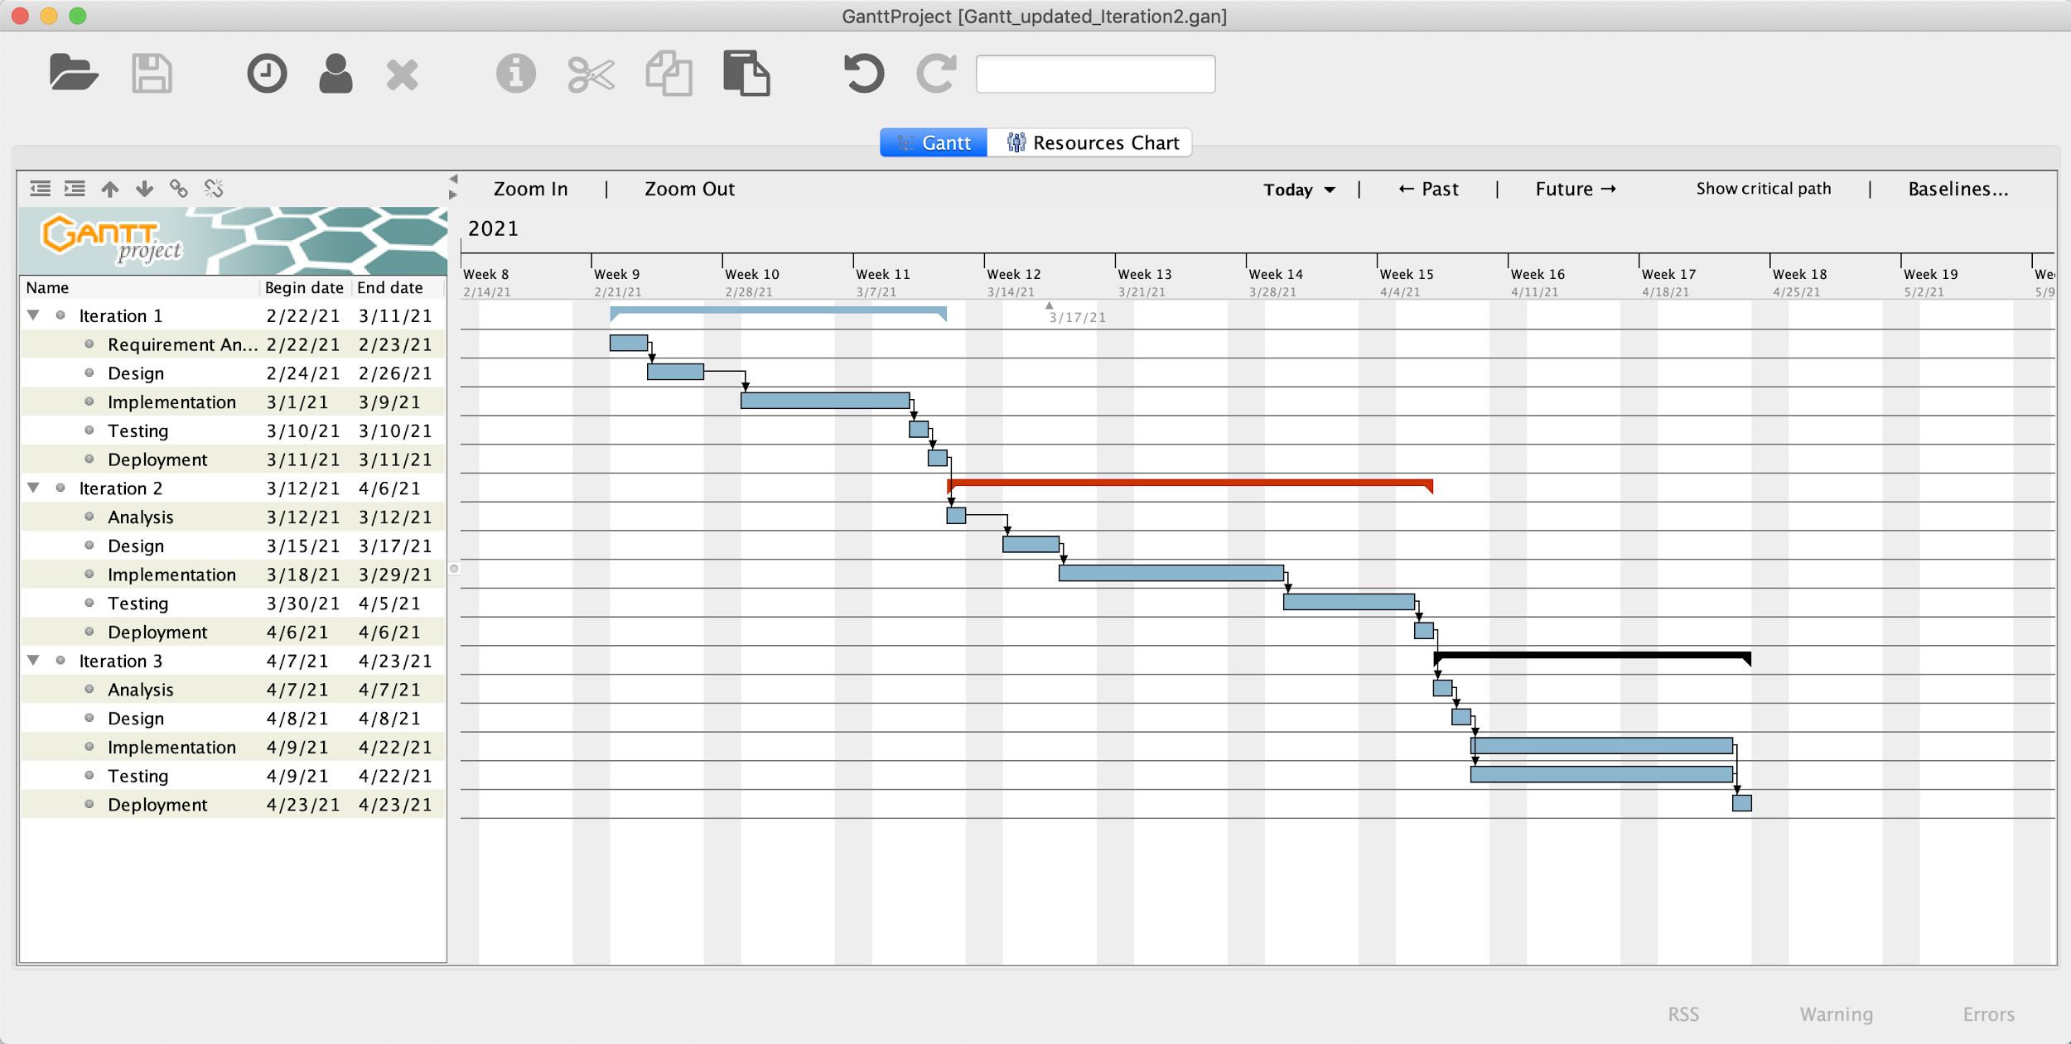
Gantt

Slide 4
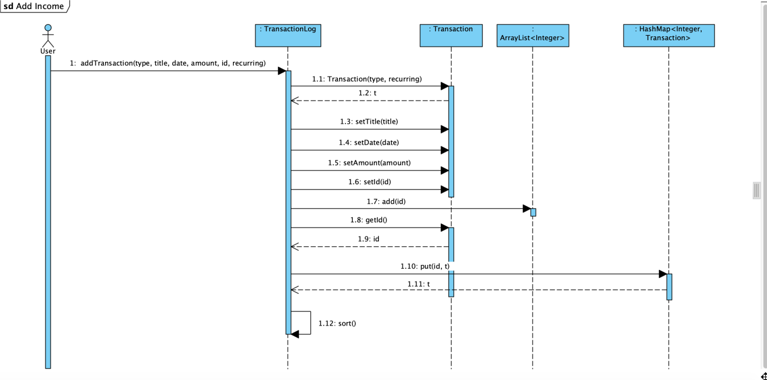
Sequence Diagram Example - Add Income

Slide 5
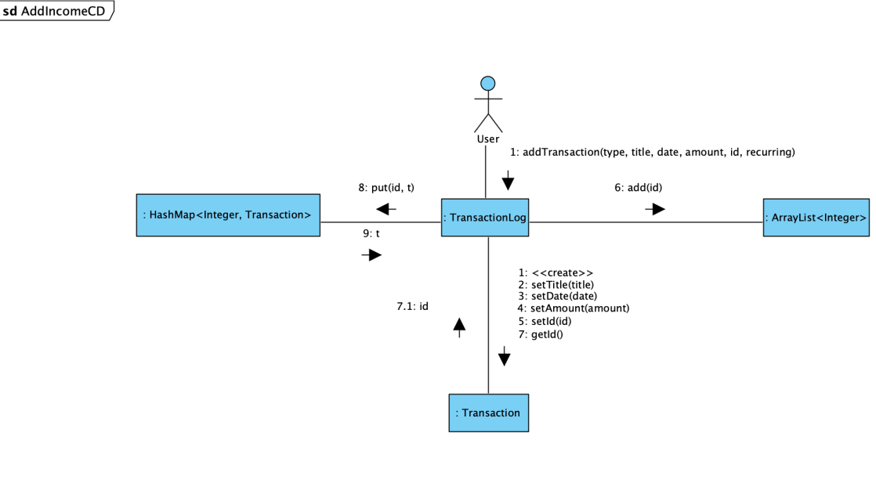
Communication Diagram Example - Add Income

Slide 6
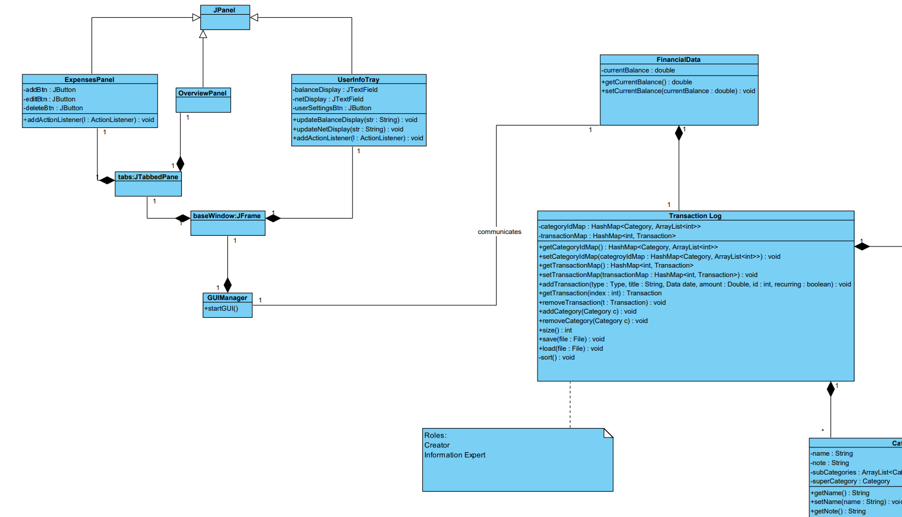
Class Diagram Part 1

Slide 7
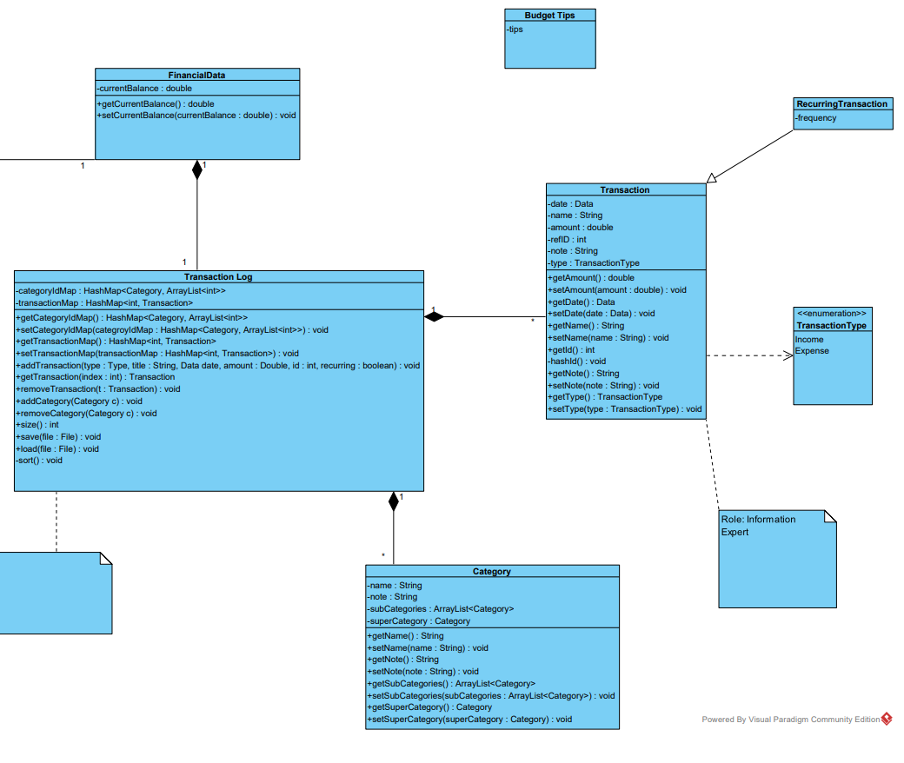
Class Diagram Part 2

Slide 8
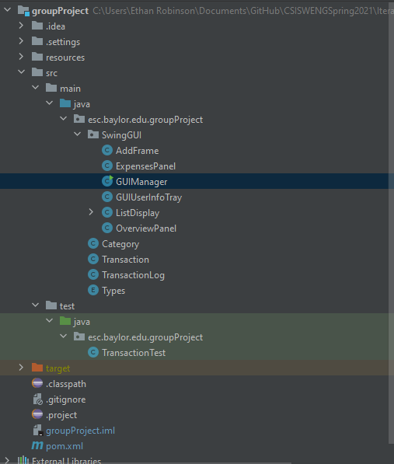
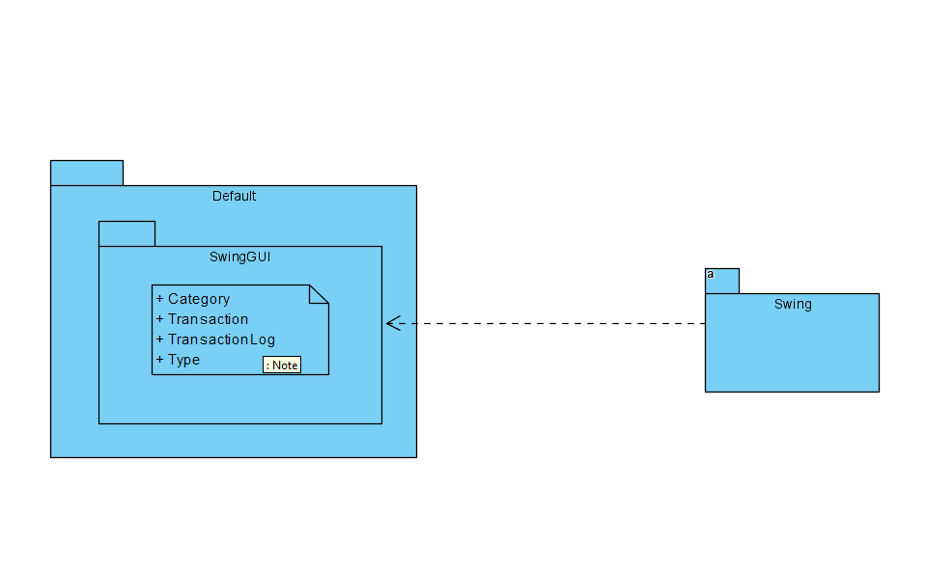
Package Diagram and Architecture

Slide 9
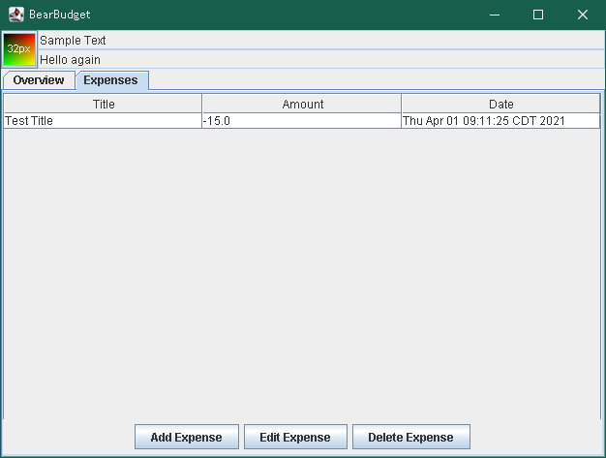
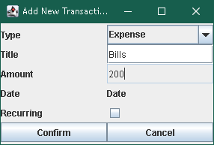
Demo

Slide 10
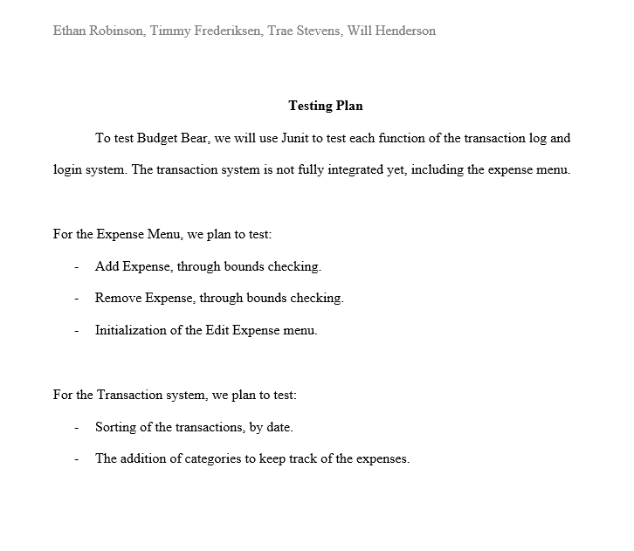
Testing

Slide 11
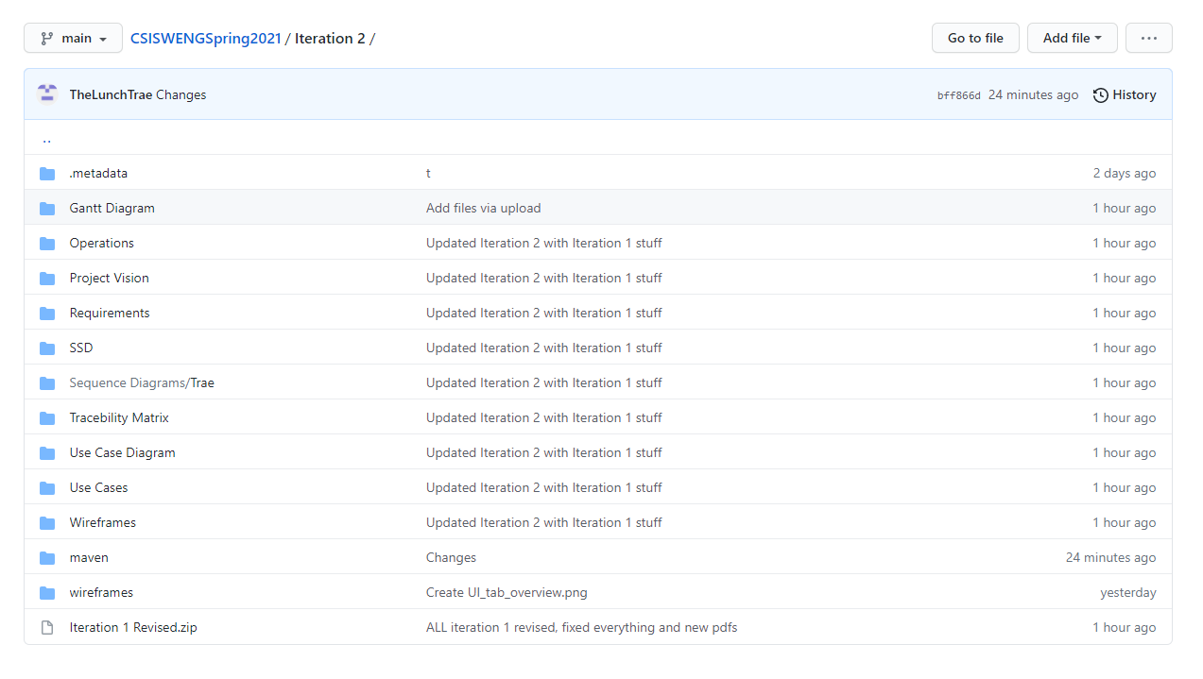
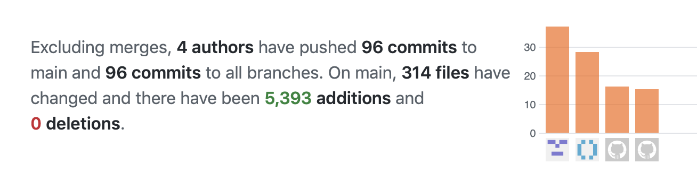
Git
Trae Timmy Ethan Will

Slide 12
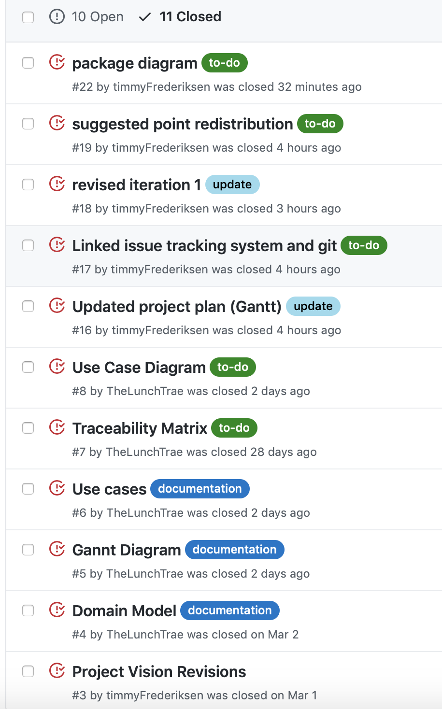
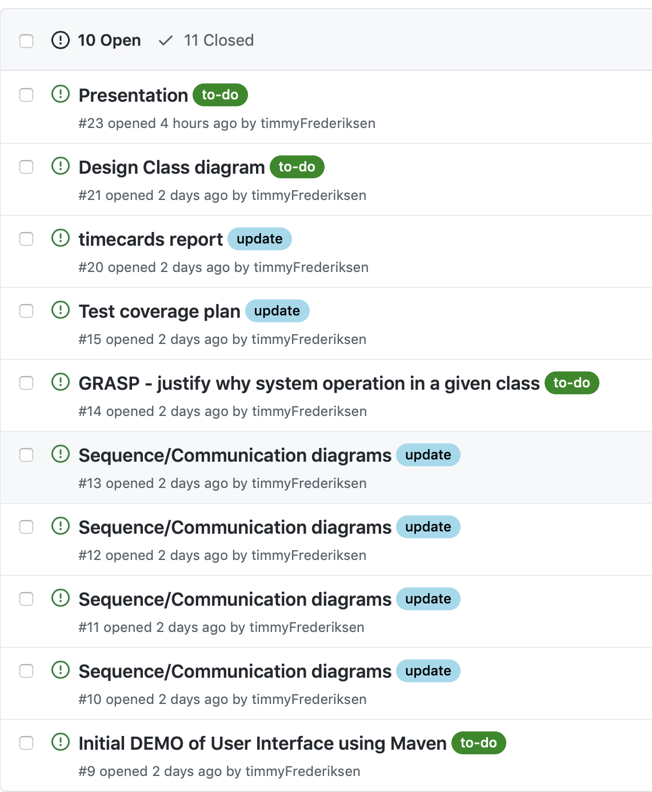
Issue Tracking - Git

Slide 13
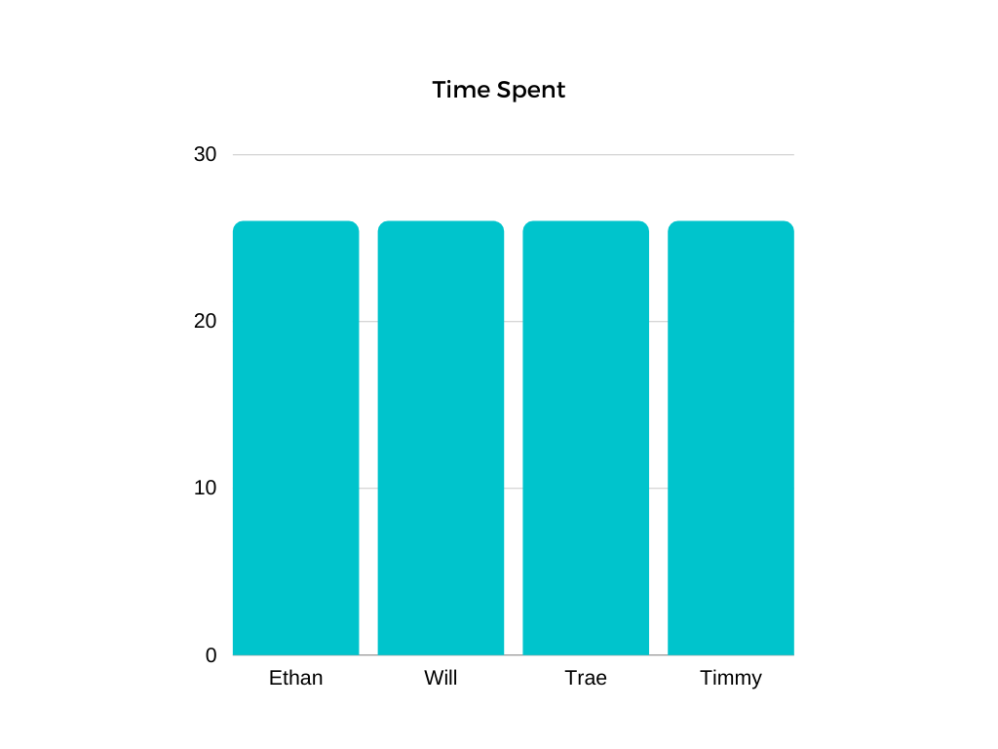
Hours Worked
About equal time at 26 hours

Slide 14
Websites
https://financemanagerapp.weebly.com/
https://github.com/someuntakenusername/CSISWENGSpring2021

